Slide 1




Data Types and Methods
Data Types, Type Conversions, Switch-Case, Methods, Debugging
Data
SoftUni Team
Technical Trainers
Software University
http://softuni.bg

Slide 2

Table of Contents
Data types and type conversion
The switch-case statement
Methods, parameters and return value
Using the debugger: tracing the program execution, breakpoints, watches
Searching for information online: Google, MSDN, Stack Overflow

Slide 3

Data Types, Variables and Type Conversions

Slide 4
How Computing Works?
Computers are machines that process data
Data is stored in the computer memory in variables
Variables have name, data type and value
Example of variable definition and assignment in C#
When processed, data is stored back into variables
Variable name
Data type
int count = 5;
Variable value

Slide 5


What Is a Data Type?
A data type:
Is a domain of values of similar characteristics
Defines the type of information stored in the computer memory (in a variable)
Examples:
Positive integers: 1, 2, 3, …
Alphabetical characters: a, b, c, …
Days of week: Monday, Tuesday, …

Slide 6
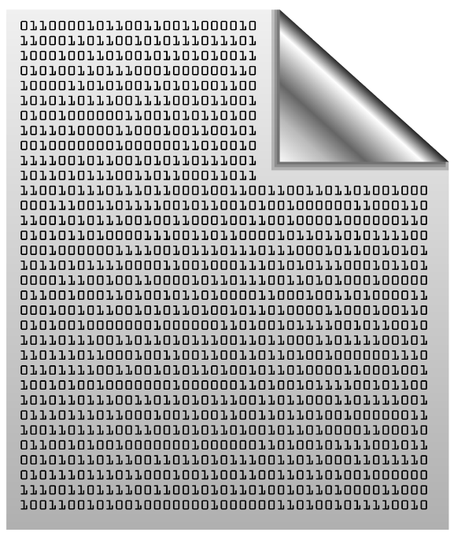

Data Type Characteristics
A data type has:
Name (C# keyword or .NET type)
Size (how much memory is used)
Default value
Example:
Integer numbers in C#
Name: int
Size: 32 bits (4 bytes)
Default value: 0
int: sequence of 32 bits in the memory
int: 4 sequential bytes in the memory

Slide 7
Integer Types
sbyte [-128 …127]: signed 8-bit [-2⁷ … 2⁷-1]
byte [0 … 255]: unsigned 8-bit [0 … 2⁸-1]
short [-32 768 … 32 767]: signed 16-bit [-2¹⁵ … 2¹⁵-1]
ushort [0 … 65 535]: unsigned 16-bit [0 … 2¹⁶-1]
int [-2 147 483 648 … 2 147 483 647]: signed 32-bit [-2³¹ … 2³¹-1]
uint [0 … 4 294 967 295]: unsigned 32-bit [0 … 2³²-1]
long [-9 223 372 036 854 775 808 … 9 223 372 036 854 775 807]: signed 64-bit [-2⁶³ … 2⁶³-1]
ulong [0 … 18 446 744 073 709 551 615]: unsigned 64-bit [0 … 2⁶⁴-1]
byte
sbyte
uint
short
int
ushort
long
ulong

Slide 8
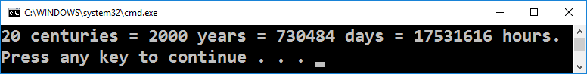
Centuries – Example
Depending on the unit of measure we can use different data types:
byte centuries = 20; // A small number (up to 255)
ushort years = 2000; // A small number (up to 32767)
uint days = 730484; // A large number (up to 4.3 billions)
ulong hours = 17531616; // A very big number (up to 18.4*10^18)
Console.WriteLine( "{0} centuries = {1} years = {2} days = {3} hours.", centuries, years, days, hours);

Slide 9
Beware of Integer Overflow!
Integers have range (minimal and maximal value)
Integers could overflow → this leads to incorrect values
int num = 10000;
for (int i = 0; i < 10; i++)
{
num = num * 5;
Console.WriteLine(num);
}
50000
250000
1250000
6250000
31250000
156250000
781250000
-388717296
-1943586480
-1127997808

Slide 10
Another Integer Overflow
8-bit types have 256 different values: [0…255]
255 + 1 → 0 (as byte)
byte counter = 0;
for (int i = 0; i < 260; i++)
{
counter++;
Console.WriteLine(counter);
}
1
2
…
255
0
1

Slide 11
Problem: Centuries to Minutes
Write program to enter an integer number of centuries and convert it to years, days, hours and minutes
Centures = 1
1 centuries = 100 years = 36524 days = 876576 hours = 52594560 minutes
Centures = 5
5 centuries = 500 years = 182621 days = 4382904 hours = 262974240 minutes
Check your solution here: https://judge.softuni.bg/Contests/Practice/Index/171#0

Slide 12
Solution: Centuries to Minutes
Console.Write("Centuries = ");
int centuries = int.Parse(Console.ReadLine());
int years = centuries * 100;
int days = (int) (years * 365.2422);
int hours = 24 * days;
int minutes = 60 * hours;
Console.WriteLine("{0} centuries = {1} years = {2} days = {3} hours = {4} minutes", centuries, years, days, hours, minutes);
Tropical year has 365.2422 days
(int) converts double to int
Check your solution here: https://judge.softuni.bg/Contests/Practice/Index/171#0

Slide 13
Problem: Centuries to Nanoseconds
Write program to enter an integer number of centuries and convert it to years, days, hours, minutes, seconds, milliseconds, microseconds, nanoseconds
Centures = 5
5 centuries = 500 years = 182621 days = 4382904 hours = 262974240 minutes = 15778454400 seconds = 15778454400000 milliseconds = 15778454400000000 microseconds = 15778454400000000000 nanoseconds
Check your solution here: https://judge.softuni.bg/Contests/Practice/Index/171#1

Slide 14
Solution: Centuries to Nanoseconds
ulong centuries = ulong.Parse(Console.ReadLine());
ulong years = centuries * 100;
ulong days = (ulong)(years * 365.2422);
ulong hours = 24 * days;
ulong minutes = 60 * hours;
ulong seconds = 60 * minutes;
ulong milliseconds = 1000 * seconds;
ulong microseconds = 1000 * milliseconds;
ulong nanoseconds = 1000 * microseconds;
// TODO: print the results
(ulong) converts double to ulong
ulong is large enough to fit 5 centuries in nanoseconds
ulong cannot fit 20 centuries in nanoseconds → use decimal
Check your solution here: https://judge.softuni.bg/Contests/Practice/Index/171#1

Slide 15
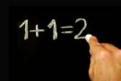
Integer Literals
int
sbyte
uint
long
byte
short
ulong
Examples of integer literals:
The '0x' and '0X' prefixes mean a hexadecimal value
E.g. 0xFE, 0xA8F1, 0xFFFFFFFF
The 'u' and 'U' suffixes mean a ulong or uint type
E.g. 12345678U, 0U
The 'l' and 'L' suffixes mean a long or ulong
E.g. 9876543L, 0L
ushort

Slide 16
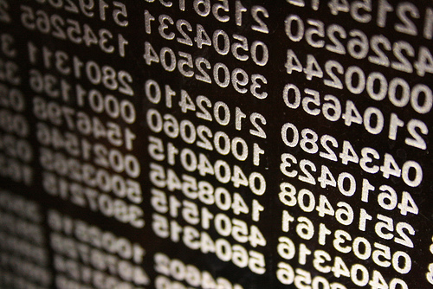
What are Floating-Point Types?
double
Floating-point types:
Represent real numbers, e.g. 1.25, -0.38
May hold very small and very big values like 0.00000000000001 and 10000000000000000000000000000000000.0
Have range and precision depending on the memory used
Sometimes behave abnormally in the calculations
float

Slide 17

Floating-Point Numbers
Floating-point types are:
float (±1.5 × 10⁻⁴⁵ to ±3.4 × 10³⁸)
32-bits, precision of 7 digits
double (±5.0 × 10⁻³²⁴ to ±1.7 × 10³⁰⁸)
64-bits, precision of 15-16 digits
The default value of floating-point types:
Is 0.0F for the float type
Is 0.0D for the double type
double
float

Slide 18
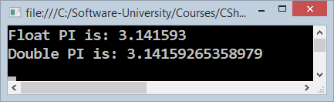
PI Precision – Example
Difference in precision when using float and double:
NOTE: The "f" suffix in the first statement!
Real numbers are by default interpreted as double!
One should explicitly convert them to float
float floatPI = 3.141592653589793238f;
double doublePI = 3.141592653589793238;
Console.WriteLine("Float PI is: {0}", floatPI);
Console.WriteLine("Double PI is: {0}", doublePI);

Slide 19
Problem: Circle Radius (12 Digits Precision)
Write program to enter a radius r (real number) and prints the area of the circle with exactly 12 digits after the decimal point:
Sample solution:
2.5
19.634954084936
1.2
4.523893421169
double r = double.Parse(Console.ReadLine());
Console.WriteLine("{0:f12}", Math.PI * r * r);
Check your solution here: https://judge.softuni.bg/Contests/Practice/Index/171#2

Slide 20
Scientific Notation
Floating-point numbers can use scientific notation, e.g.
1e+34, 1E34, 20e-3, 1e-12, -6.02e28
double d = 10000000000000000000000000000000000.0;
Console.WriteLine(d); // 1E+34
double d2 = 20e-3;
Console.WriteLine(d2); // 0.02
double d3 = double.MaxValue;
Console.WriteLine(d3); // 1.79769313486232E+308

Slide 21
Floating-Point Division
Integral division and floating-point division are different:
Console.WriteLine(10 / 4); // 2 (integral division)
Console.WriteLine(10 / 4.0); // 2.5 (real division)
Console.WriteLine(10 / 0.0); // Infinity
Console.WriteLine(-10 / 0.0); // -Infinity
Console.WriteLine(0 / 0.0); // NaN (not a number)
Console.WriteLine(8 % 2.5); // 0.5 (3 * 2.5 + 0.5 = 8)
int d = 0;
Console.WriteLine(10 / d); // DivideByZeroException

Slide 22

Floating-Point Calculations – Abnormalities
Sometimes floating-point numbers work incorrectly!
Console.WriteLine(100000000000000.0 + 0.3);
// Result: 100000000000000 (loss of precision)
double a = 1.0f, b = 0.33f, sum = 1.33;
Console.WriteLine("a+b={0} sum={1} equal={2}",
a+b, sum, (a+b == sum));
// a+b=1.33000001311302 sum=1.33 equal=False
double one = 0;
for (int i = 0; i < 10000; i++) one += 0.0001;
Console.WriteLine(one); // 0.999999999999906

Slide 23

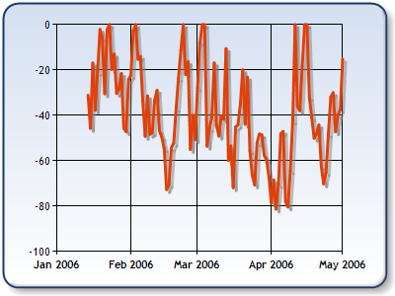
Decimal Floating-Point Type
There is a special decimal floating-point real number type in C#:
decimal (±1,0 × 10⁻²⁸ to ±7,9 × 10²⁸)
128-bits, precision of 28-29 digits
Used for financial calculations
Almost no round-off errors
Almost no loss of precision
The default value of decimal type is:
0.0M (M is the suffix for decimal numbers)
decimal

Slide 24
Problem: Exact Sum of Real Numbers
Write program to enter n numbers and print their exact sum:
2
1000000000000000000
5
1000000000000000005
2
0.00000000003
333333333333.3
333333333333.30000000003
Check your solution here: https://judge.softuni.bg/Contests/Practice/Index/171#3

Slide 25
Solution: Exact Sum of Real Numbers
This code works but makes mistakes sometimes:
Try to change double with decimal and check the differences
int n = int.Parse(Console.ReadLine());
double sum = 0.0;
for (int i = 0; i < n; i++)
sum += double.Parse(Console.ReadLine());
Console.WriteLine(sum);
Check your solution here: https://judge.softuni.bg/Contests/Practice/Index/171#3

Slide 26

Integer and Real Numbers
double
int
long
float
decimal
Live Exercises in Class (Lab)

Slide 27
Rounding Floating-Point Numbers
Math.Round(3.45) – round to integer number (mathematically)
Math.Round(2.3455, 3) – round with precision
Math.Ceiling() – round up to the nearest integer
Math.Floor() – round down to the nearest integer
Banker's rounding:
2.5 → 2
3.5 → 4
3.45 → 3
double a = 2.3455;
Console.WriteLine(Math.Round(a)); // result: 2
Console.WriteLine(Math.Round(a, 3)); // result: 2.346
Console.WriteLine(Math.Ceiling(a)); // result: 3
Console.WriteLine(Math.Floor(a)); // result: 2

Slide 28
Type Conversion
Variables hold values of certain type
Type can be changed (converted) to another type
Implicit type conversion (lossless): variable of bigger type (e.g. double) takes smaller value (e.g. float)
Explicit type conversion (lossy) – when precision can be lost:
float heightInMeters = 1.74f;
double maxHeight = heightInMeters; // Implicit conversion
double size = 3.14;
int intSize = (int) size; // Explicit conversion → 3

Slide 29
Problem: Elevator
Calculate how many courses will be needed to elevate n persons by using an elevator of capacity of p persons
Sample solution:
persons = 16
capacity = 3
6 courses
5 courses * 3 people + 1 course * 1 person
int n = int.Parse(Console.ReadLine());
int p = int.Parse(Console.ReadLine());
int courses = (int) Math.Ceiling((double)n / p);
Console.WriteLine(courses);
Check your solution here: https://judge.softuni.bg/Contests/Practice/Index/171#4

Slide 30
Boolean Type
Boolean variables (bool) hold true or false:
int a = 1;
int b = 2;
bool greaterAB = (a > b);
Console.WriteLine(greaterAB); // False
bool equalA1 = (a == 1);
Console.WriteLine(equalA1); // True

Slide 31
Problem: Special Number
A number is special when its sum of digits is 5, 7 or 11
For all numbers 1…n print the number and if it is special
1 -> False
2 -> False
3 -> False
4 -> False
5 -> True
6 -> False
7 -> True
8 -> False
9 -> False
10 -> False
11 -> False
12 -> False
13 -> False
14 -> True
15 -> False
16 -> True
17 -> False
18 -> False
19 -> False
20 -> False
20
Check your solution here: https://judge.softuni.bg/Contests/Practice/Index/171#5

Slide 32
Solution: Special Number
int n = int.Parse(Console.ReadLine());
for (int num = 1; num <= n; num++)
{
int sumOfDigits = 0;
int digits = num;
while (digits > 0)
{
sumOfDigits += digits % 10;
digits = digits / 10;
}
bool special = (sumOfDigits == 5) || …; // TODO: finish this
Console.WriteLine("{0} -> {1}", num, special);
}
Check your solution here: https://judge.softuni.bg/Contests/Practice/Index/171#5

Slide 33
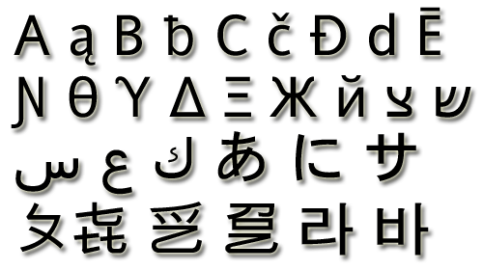
The Character Data Type
The character data type:
Represents symbolic information
Is declared by the char keyword
Gives each symbol a corresponding integer code
Has a '\0' default value
Takes 16 bits of memory (from U+0000 to U+FFFF)
Holds a single Unicode character (or part of character)

Slide 34
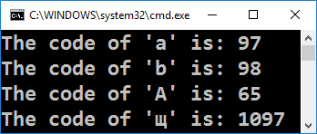
Characters and Codes
Each character has an unique Unicode value (int):
char ch = 'a';
Console.WriteLine("The code of '{0}' is: {1}", ch, (int) ch);
ch = 'b';
Console.WriteLine("The code of '{0}' is: {1}", ch, (int) ch);
ch = 'A';
Console.WriteLine("The code of '{0}' is: {1}", ch, (int) ch);
ch = 'щ'; // Cyrillic letter 'sht'
Console.WriteLine("The code of '{0}' is: {1}", ch, (int) ch);

Slide 35
Problem: Triples of Latin Letters
Write a program to read an integer n and print all triples of the first n small Latin letters, ordered alphabetically:
aaa
aab
aac
aba
abb
abc
aca
acb
acc
baa
bab
bac
bba
bbb
bbc
bca
bcb
bcc
caa
cab
cac
cba
cbb
cbc
cca
ccb
ccc
3
Check your solution here: https://judge.softuni.bg/Contests/Practice/Index/171#6

Slide 36
Solution: Triples of Latin Letters
int n = int.Parse(Console.ReadLine());
for (int i1 = 0; i1 < n; i1++)
for (int i2 = 0; i2 < n; i2++)
for (int i3 = 0; i3 < n; i3++)
{
char letter1 = (char)('a' + i1);
char letter2 = // TODO: finish this
char letter3 = // TODO: finish this
Console.WriteLine("{0}{1}{2}",
letter1, letter2, letter3);
}
Check your solution here: https://judge.softuni.bg/Contests/Practice/Index/171#6

Slide 37
Escaping Characters
Escaping sequences are:
Represent a special character like ', " or \n (new line)
Represent system characters (like the [TAB] character \t)
Commonly used escaping sequences are:
\' → for single quote \" → for double quote
\\ → for backslash \n → for new line
\uXXXX → for denoting any other Unicode symbol

Slide 38
Character Literals – Example
char symbol = 'a'; // An ordinary character
symbol = '\u006F'; // Unicode character code in a
// hexadecimal format (letter 'o')
symbol = '\u8449'; // 葉 (Leaf in Traditional Chinese)
symbol = '\''; // Assigning the single quote character
symbol = '\\'; // Assigning the backslash character
symbol = '\n'; // Assigning new line character
symbol = '\t'; // Assigning TAB character
symbol = "a"; // Incorrect: use single quotes!

Slide 39

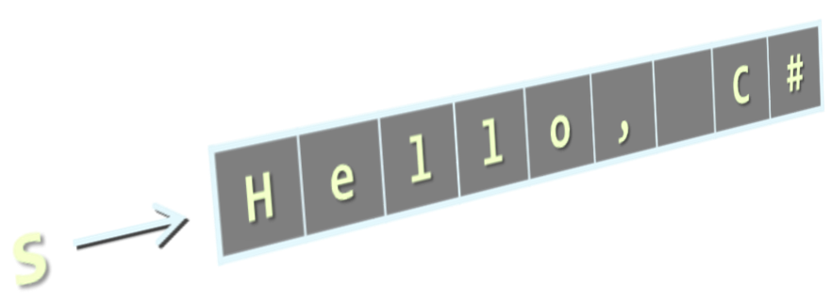
The String Data Type
The string data type:
Represents a sequence of characters
Is declared by the string keyword
Has a default value null (no value)
Strings are enclosed in quotes:
Strings can be concatenated
Using the + operator
string
string s = "Hello, C#";

Slide 40
Verbatim and Interpolated Strings
Strings are enclosed in quotes "":
Strings can be verbatim (no escaping):
Interpolated strings insert variable values by pattern:
The backslash \ is escaped by \\
string file = "C:\\Windows\\win.ini";
The backslash \ is not escaped
string file = @"C:\Windows\win.ini";
string firstName = "Svetlin";
string lastName = "Nakov";
string fullName = $"{firstName} {lastName}";

Slide 41
Saying Hello – Examples
Combining the names of a person to obtain the full name:
We can concatenate strings and numbers by the + operator:
string firstName = "Ivan";
string lastName = "Ivanov";
Console.WriteLine(@"Hello, ""{0}""!", firstName);
string fullName = $"{firstName} {lastName}";
Console.WriteLine("Your full name is {0}.", fullName);
int age = 21;
Console.WriteLine("Hello, I am " + age + " years old");

Slide 42
Problem: Greeting by Name and Age
Write a program that enters first name, last name and prints "Hello, <first name> <last name>. You are <age> years old."
string firstName = Console.ReadLine();
string lastName = Console.ReadLine();
string ageStr = Console.ReadLine();
int age = int.Parse(ageStr); // Parse string → int
Console.WriteLine($"Hello, {firstName} {lastName}.\r\nYou are {age} years old.");
Check your solution here: https://judge.softuni.bg/Contests/Practice/Index/171#7

Slide 43

The switch-case Statement
The Better If-Else-If-Else?

Slide 44
The switch-case Statement
The switch-case works as long if-else-if-else sequence
Problem: print the day name (in English) by day number (1…7)
int day = int.Parse(Console.ReadLine());
switch (day)
{
case 1: Console.WriteLine("Monday"); break;
case 2: Console.WriteLine("Tuesday"); break;
…
case 7: Console.WriteLine("Sunday"); break;
default: Console.WriteLine("Error!"); break;
}
Check your solution here: https://judge.softuni.bg/Contests/Practice/Index/171#8

Slide 45
Multiple Labels in Switch Case
Write a program to print animal type by its name: dog → mammal; crocodile, tortoise, snake → reptile; others → unknown
switch (animal)
{
case "dog": Console.WriteLine("mammal"); break;
case "crocodile":
case "tortoise":
case "snake": Console.WriteLine("reptile"); break;
default: Console.WriteLine("unknown"); break;
}
Check your solution here: https://judge.softuni.bg/Contests/Practice/Index/171#9

Slide 46
Data Types and Type Conversion
string
(int) value
bool
switch
case
char
Live Exercises in Class (Lab)

Slide 47
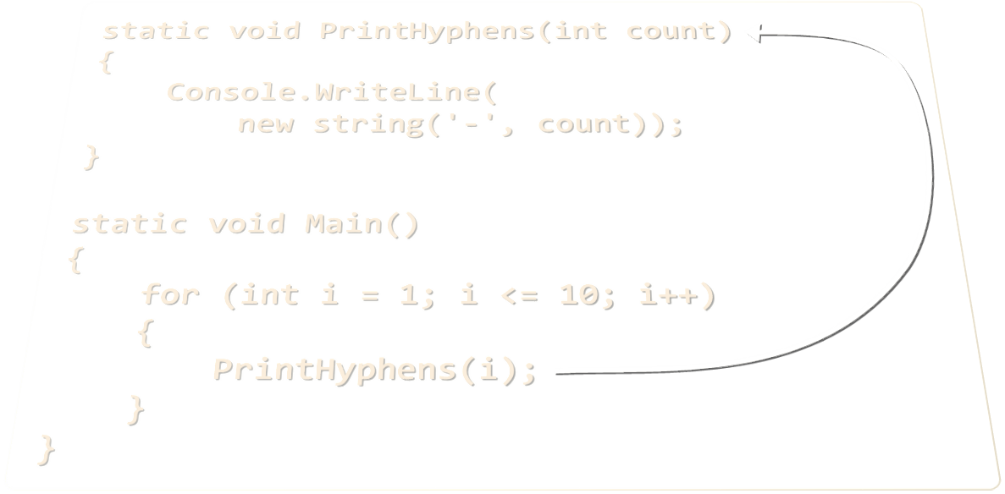
Methods
Methods, Parameters and Return Value

Slide 48
Simple Methods
Methods are named pieces of code that can be invoked later
Sample method definition:
Invoking (calling) the method several times:
Method named PrintHeader
static void PrintHeader()
{
Console.WriteLine("----------");
}
Method body always surrounded by { }
PrintHeader();
PrintHeader();

Slide 49
Problem: Draw а Filled Square
Draw at the console a filled square of size n like in the example:
static void PrintHeaderRow(int n)
{
Console.WriteLine(new
string('-', 2 * n));
}
static void PrintMiddleRow(int n)
{
Console.Write('-');
for (int i = 1; i < n; i++)
Console.Write("\\/");
Console.WriteLine('-');
}
--------
-\/\/\/-
-\/\/\/-
--------
4
Method with parameter n
static void Main() {
int n = // TODO: read n
PrintHeaderRow(n);
for (int i = 0; i < n - 2; i++)
PrintMiddleRow(n);
PrintHeaderRow(n);
}
Check your solution here: https://judge.softuni.bg/Contests/Practice/Index/171#10

Slide 50
Problem: Master Numbers
A master number is an integer that holds the following properties:
Is symmetric (palindrome), e.g. 5, 77, 282, 14341, 9553559
Its sum of digits is divisible by 7, e.g. 77, 313, 464, 5225, 37173
Holds at least one even digit, e.g. 232, 707, 6886, 87578
Write a program to print all master numbers in the range [1…n]
232
383
464
545
232
383
464
545
626
696
707
858
1661
2552
3443
4334
600
5000
Check your solution here: https://judge.softuni.bg/Contests/Practice/Index/171#11

Slide 51
Solution: Master Numbers
Methods returning values will simplify our algorithm:
Method returns a result of type bool
static bool IsPalindrome(int num)
{
string digits = "" + num;
for (int i = 0; i < digits.Length / 2; i++)
if (digits[i] != digits[digits.Length - i - 1])
return false;
return true;
}
Return a value as a result of the method call

Slide 52
Solution: Master Numbers (2)
static int SumOfDigits(int num)
{
int sum = 0;
while (num > 0)
{
sum += num % 10;
num = num / 10;
}
return sum;
}
Method returns a result of type int

Slide 53
Solution: Master Numbers (3)
static bool ContainsEvenDigit(int num)
{
string digits = "" + num;
for (int i = 0; i < digits.Length; i++)
{
int digit = digits[i] - '0';
// TODO: return true if the digit is even
}
return false;
}

Slide 54
Solution: Master Numbers (4)
static void Main()
{
int n = int.Parse(Console.ReadLine());
for (int num = 1; num <= n; num++)
if (IsPalindrome(num) &&
(SumOfDigits(num) % 7 == 0) &&
ContainsEvenDigit(num))
{
Console.WriteLine(num);
}
}
Check your solution here: https://judge.softuni.bg/Contests/Practice/Index/171#11

Slide 55



Debugging the Code
Using the Visual Studio Debugger

Slide 56



Debugging The Code
The process of debugging application includes:
Spotting an error
Finding the lines of code that cause the error
Fixing the error in the code
Testing to check if the error is gone and no new errors are introduced
Iterative and continuous process
Debuggers help a lot

Slide 57
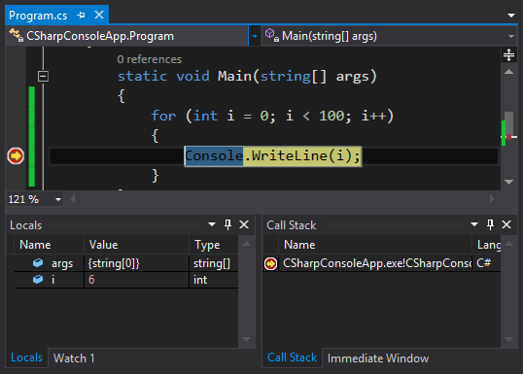
Debugging in Visual Studio
Visual Studio has a built-in debugger
It provides:
Breakpoints
Ability to trace the code execution
Ability to inspect variables at runtime

Slide 58
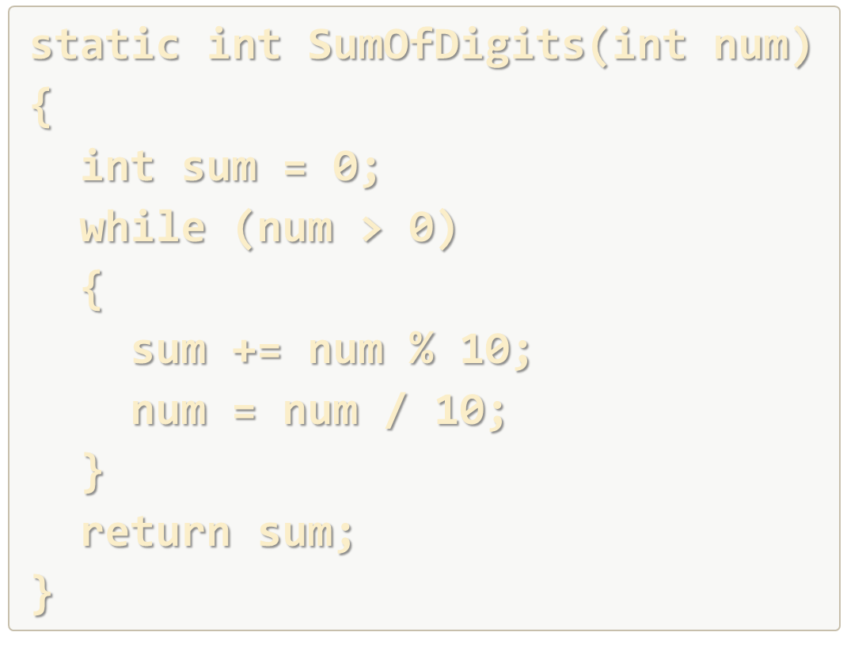
Methods and Debugging
Live Exercises in Class (Lab)

Slide 59
Searching for Information Online
Google, MSDN, Stack Overflow

Slide 60
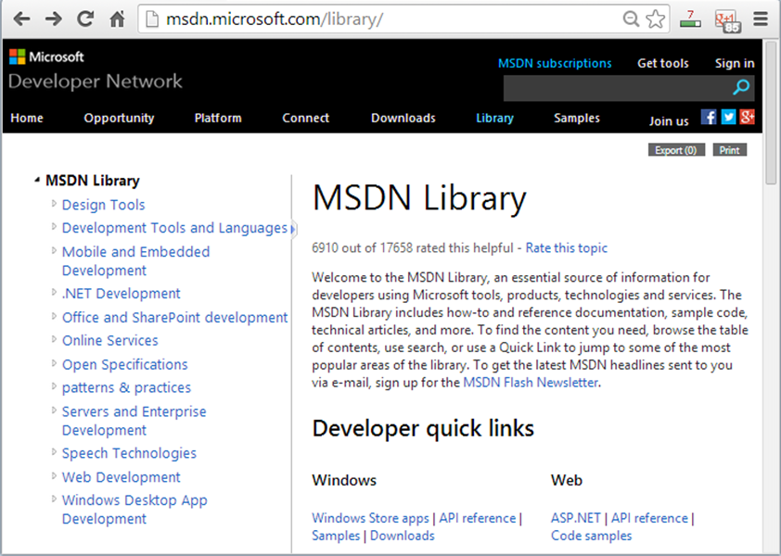
What is MSDN Library?
Complete documentation of all classes and their functionality
With descriptions of all methods, properties, events, etc.
With code examples
For all Microsoft technologies
Related articles
Library of samples
MSDN Library is available at msdn.microsoft.com/library

Slide 61

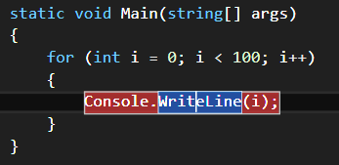
How to Use MSDN Library?
Search in Google for certain class / method / property
E.g.
Or
Or
Use Visual Studio's built-in help system
Press [F1] in Visual Studio in the code
Browse http://msdn.microsoft.com
Press [F1] to view the documentation

Slide 62


Summary
Classical data types:
Integer numbers: 8-bit, 16-bit, 32-bit, 64-bit, signed / unsigned, e.g. 0, 42, -127, 100000
Floating-point numbers (float, double), e.g. 3.14, -0.5, 1e-56 (have precision and range), good for physics, not for money!
Decimal floating-point (decimal) – 128-bit, for financial calculations / large precision
Methods are named pieces of code that can be invoked later (with parameters)

Slide 63








Data Types and Methods
https://softuni.bg/courses/programming-basics/

Slide 64
License
This course (slides, examples, demos, videos, homework, etc.) is licensed under the "Creative Commons Attribution-NonCommercial-ShareAlike 4.0 International" license
Attribution: this work may contain portions from
"Fundamentals of Computer Programming with C#" book by Svetlin Nakov & Co. under CC-BY-SA license

Slide 65






Free Trainings @ Software University
Software University Foundation – softuni.org
Software University – High-Quality Education, Profession and Job for Software Developers
softuni.bg
Software University @ Facebook
facebook.com/SoftwareUniversity
Software University @ YouTube
youtube.com/SoftwareUniversity
Software University Forums – forum.softuni.bg

